Slide 1
Elections

Slide 2
An algorithm for choosing a unique process to play a particular role is called an election algorithm.
If the process that plays the role of server wishes to retire then another election is required to choose a replacement.

Slide 3
An individual process does not call more than one election at a time.
But the N processes could call N concurrent elections.
At any point in time, a process p_{i} is either a participant (engaged in election algorithm) non-participant (not currently engaged in any election)

Slide 4
The elected process be chosen
with the largest identifier.
with the lowest computational load by having each process use <1 / load , i > as its identifier,
where load > 0 and the process index i is used to order identifiers with the same load

Slide 5
Each process p_{i} ( i = 1,2….N ) has a variable elected_{i} , which will contain the identifier of the elected process.
When the process first becomes a participant in an election it sets this variable to the special value ‘ ’ to denote that it is not yet defined.

Slide 6
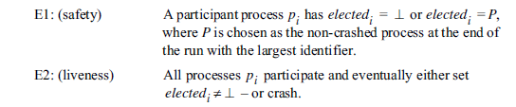

Slide 7
The performance of an election algorithm is measured by its total network bandwidth utilization (which is proportional to the total number of messages sent)
Turnaround time for the algorithm: the number of serialized message transmission times between the initiation and termination of a single run.

Slide 8
Ring based election algorithm
Each process p_{i} has a communication channel to the next process in the ring, (p_{i + 1}mod N) , and all messages are sent clockwise around the ring.
The goal of this algorithm is to elect a single process called the coordinator, which is the process with the largest identifier.
Initially, every process is marked as a non-participant in an election.
Any process can begin an election. It proceeds by marking itself as a participant and placing its identifier in an election message and sending it to its clockwise neighbour.

Slide 9
When a process receives an election message, it compares the identifier in the message with its own.
If the arrived identifier is greater, then it forwards the message to its neighbour.
If the arrived identifier is smaller and the receiver is not a participant, then it substitutes its own identifier in the message and forwards it;
but it does not forward the message if it is already a participant.

Slide 10
If, however, the received identifier is that of the receiver itself, then this process’s identifier must be the greatest, and it becomes the coordinator.
The coordinator marks itself as a non-participant once more and sends an elected message to its neighbour, announcing its election and enclosing its identity.
When a process p_{i} receives an elected message, it marks itself as a nonparticipant, sets its variable elected_{i} to the identifier in the message and, unless it is the new coordinator, forwards the message to its neighbour.

Slide 11
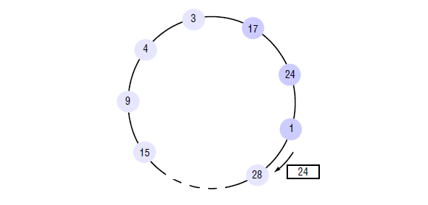

Slide 12
Bully algorithm
Unlike the ring-based algorithm, this algorithm assumes that the system is synchronous.
It uses timeouts to detect a process failure.
Another difference is that the ring-based algorithm assumed that processes have a minimal priori knowledge of one another.
Each knows only how to communicate with its neighbour, and none knows the identifiers of the other processes.
The bully algorithm, on the other hand, assumes that each process knows which processes have higher identifiers, and that it can communicate with all such processes.

Slide 13
There are three types of message in this algorithm:
Election message is sent to announce an election.
Answer message is sent in response to an election message
coordinator message is sent to announce the identity of the elected process – the new‘coordinator’.
A process begins an election when it notices, through timeouts, that the coordinator has failed.
Several processes may discover this concurrently.

Slide 14
we can construct a reliable failure detector.
There is a maximum message transmission delay, T_{trans .} and a maximum delay for processing a message T_{process}
Therefore, we can calculate a time T = 2T_{trans} + T_{process} .
This is an upper bound on the time that can elapse between sending a message to another process and receiving a response.
If no response arrives within time T, then the local failure detector can report that the intended recipient of the request has failed.

Slide 15
The process that knows it has the highest identifier can elect itself as the coordinator simply by sending a coordinator message to all processes with lower identifiers.
On the other hand, a process with a lower identifier can begin an election by sending an election message to those processes that have a higher identifier and awaiting answer messages in response.
If none arrives within time T, the process considers itself the coordinator and sends a coordinator message to all processes with lower identifiers announcing this.
Otherwise, the process waits a further period T, for a coordinator message to arrive from the new coordinator. If none arrives, it begins another election

Slide 16
If a process p_{i} receives a coordinator message, it sets its variable elected_{i} to the identifier of the coordinator contained within it and treats that process as the coordinator.
If a process receives an election message, it sends back an answer message and begins another election – unless it has begun one already.
When a process is started to replace a crashed process, it begins an election.
If it has the highest process identifier, then it will decide that it is the coordinator and announce this to the other processes.
Thus it will become the coordinator, even though the current coordinator is functioning. It is for this reason that the algorithm is called the ‘bully’ algorithm.

Slide 17
